Slide 1

Correlaid Paris in Numbers
Velib situation

Slide 2
Situation
🎯 Objective: Increase the offer of bicycle parking
Visualise the existing situation
Find trends in user behaviour

Slide 3
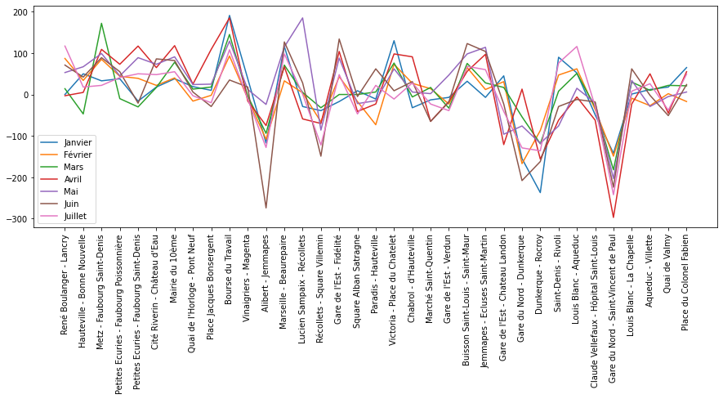
Arrival vs Departure by months for all sations

Slide 4
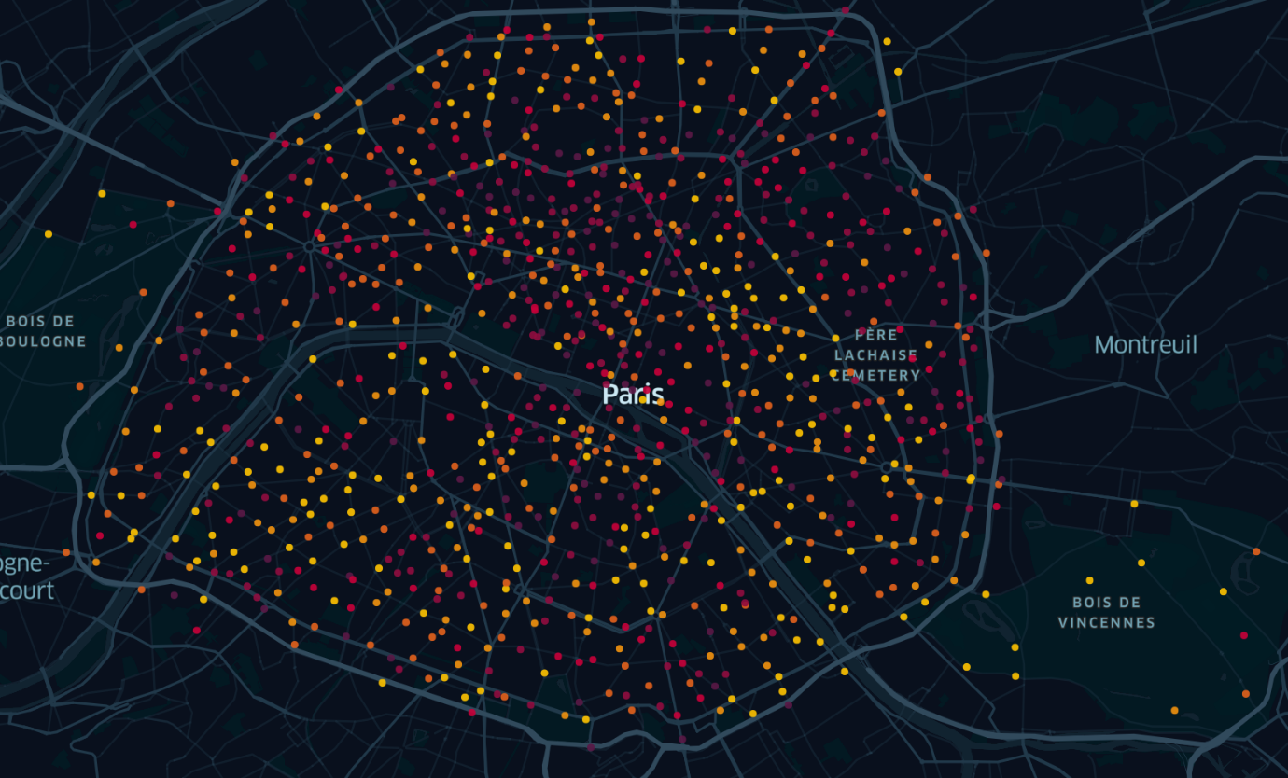
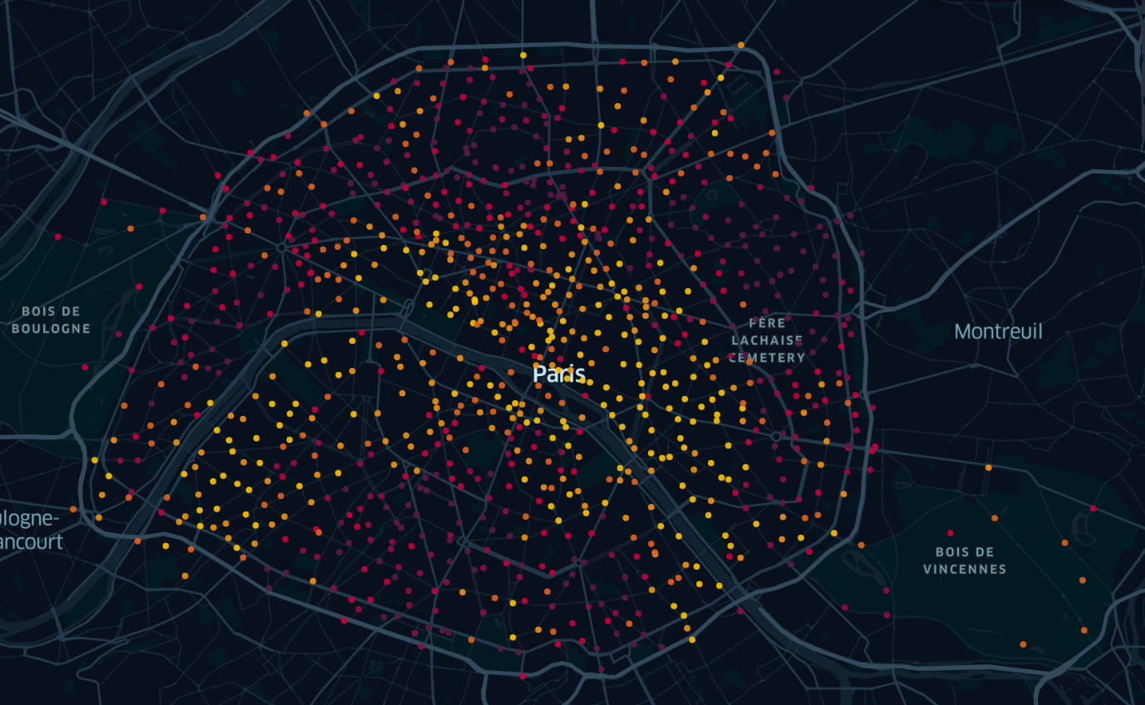
Map of velib stations and traffic
Velib station capacity
Arrival vs Departure traffic
Legend
Yellow: high capacity
Purple: low capacity
Legend
Yellow: More arrival
Purple: Less arrival

Slide 5


Map of velib stations and traffic
Velib station capacity
Arrival vs Departure traffic
Legend
Yellow: high capacity
Purple: low capacity
Legend
Yellow: More arrival
Purple: Less arrival

Slide 6
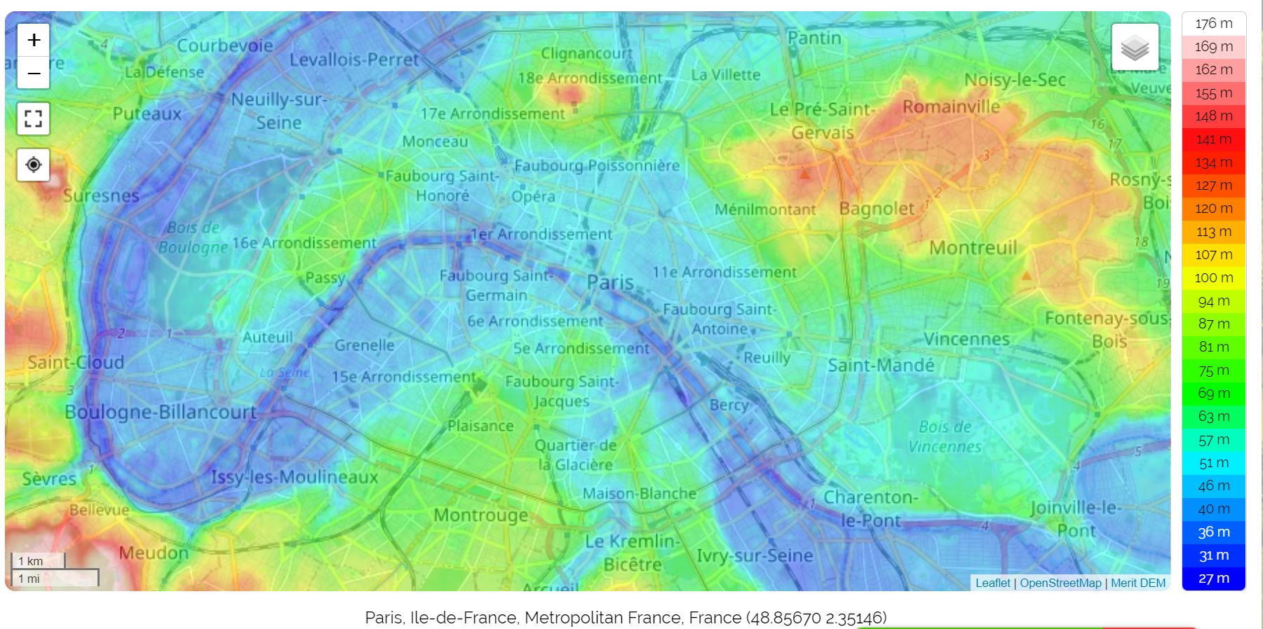
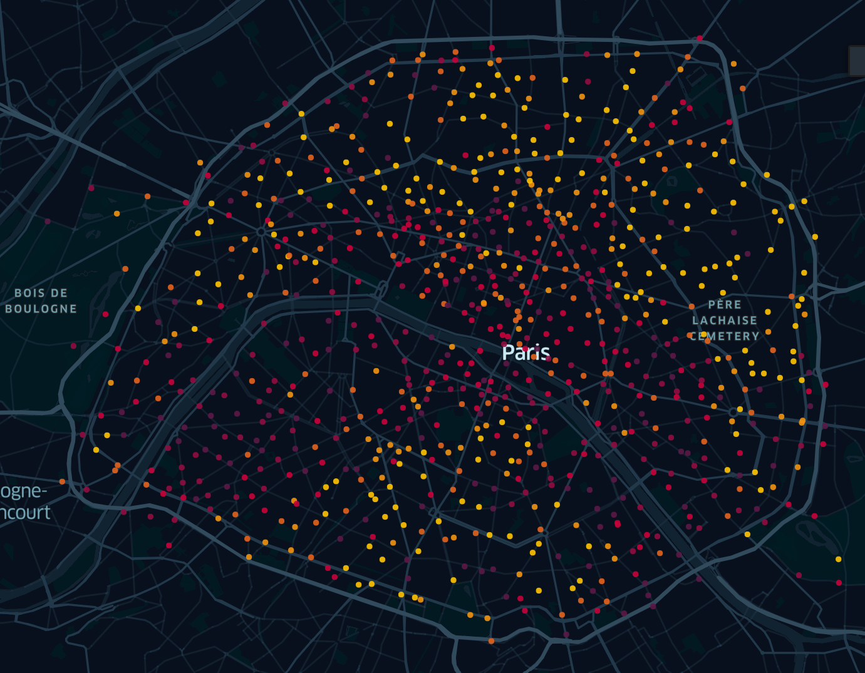
Topography of Paris vs Electronic ratio
Topographic map of Paris
Electronic velib ratio
Legend
Yellow: More electronic velibs
Purple: More mechanical velibs

Slide 7
Conclusion
Users take velibs to go to the center of Paris but do not return home with them.
Some stations in the centre lack sufficient capacity to accommodate velibs.
Correlation between electrical velibs and the topography of Paris.

